Slide 1
Name: Thomas Hoad Candidate Number: 2306 School: Calthorpe Park School Subject: Computing Centre Number: 58333
Task 1 Formal Testing – Tom H
Test number: | What to test: | How to test it: | Expected Result: | Actual Result:
1 – A 1 – B 1 – C 1 – D 1 – E | Can the user enter a sentence? What happens if nothing if entered. What if only spaces entered into the input box? | Press the ‘Enter a sentence:’ button. An input box will appear where the user can enter a sentence. Press enter on the sentence input box with nothing entered. Enter: “ “ into the sentence input box. | The sentence will be registered and shown in the list box. “Your sentence is:…” “Your sentence is: ASK NOT WHAT YOUR COUNTRY CAN DO FOR YOU ASK WHAT YOU CAN DO FOR YOUR COUNTRY” “Your sentence is: ‘Hello my name is Tom Hoad’” “You need to enter a sentence!” “Your sentence is: “ “ | Positive Positive Positive Positive Positive
2 – A 2 - B | Can the user enter a word? | Press the ‘Check a word:’ button. An input box will appear where the user can enter a word. | The position of the word will be relayed. “…Is in the position:…” “’Country’ is in the position: 5 ‘Country is in the position: 17” | Positive Positive

Slide 2
Name: Thomas Hoad Candidate Number: 2306 School: Calthorpe Park School Subject: Computing Centre Number: 58333
Test number: | What to test: | How to test it: | Expected Result: | Actual Result:
2 – C 2 - D 2 – E 2 – F | What happens if nothing is entered? What if only spaces entered into the input box? What if the word is not in the sentence? | Press enter on the word input box with nothing entered. Enter: “ “ into the word input box. Enter the sentence: “Hello my name is Tom!” and then check “Hi” | “’Tom’ is in the position: 5” “You need to enter a word!” “The word “ “ => Failed” Error Message & “The word “Hi” => Failed” | Positive Positive Positive
3 – A 3 – B 3 – C | What if two words are inputted to be checked. What if a sentence is added with punctuation. What happens if a word is case sensitive. | Enter: “Tom Tom” into the word input box. Enter the sentence: “Hello my name is Tom!” and then check “Tom” Enter the sentence: “HELLO my name is Tom” Check: “HELLO” & “hello” & “TOM” & “Tom” & “tom” | Error Message & “The word ”Tom Tom” => Failed “”Tom” is in the position: 5” “”HELLO” is in the position: 1 “hello” is in the position: 1 “TOM” is in the position: 5 “Tom” is in the position: 5 “tom is in the position: 5” | Positive Negative “The word ”Tom” => Failed” Positive

Slide 3
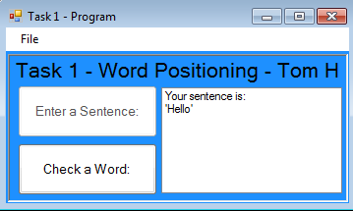
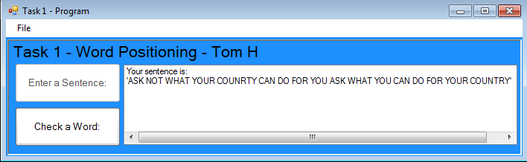
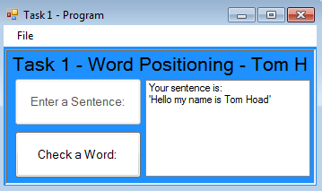
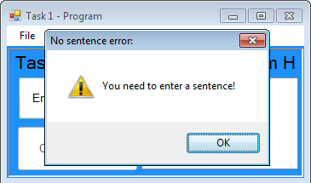
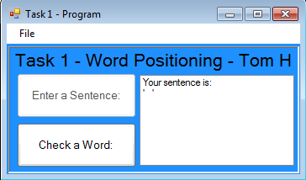
Name: Thomas Hoad Candidate Number: 2306 School: Calthorpe Park School Subject: Computing Centre Number: 58333
Test number: | What to test: | How to test it: | Expected Result: | Actual Result:
4 – A 4 – B 4 – C | Does the reset button work? Does the clear button work? Does the exit button work? | Press the reset button from the menu strip. Press the clear button from the menu strip. Press the exit button from the menu strip. | The sentence button will be enabled and the word button will be disabled. The list box will be cleared. The list box is cleared entirely with the exception of the sentence. A warning message and then the program will close. | Positive Positive Positive
Testing screenshots:
Figure 1 – A: Figure 1 – B:
Figure 1 – C: Figure 1 – D: Figure 1 – E:

Slide 4
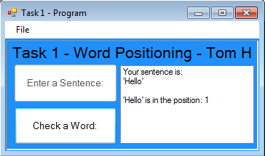
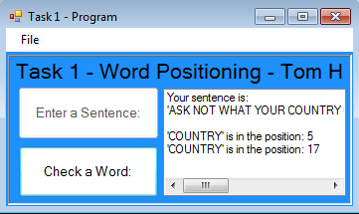
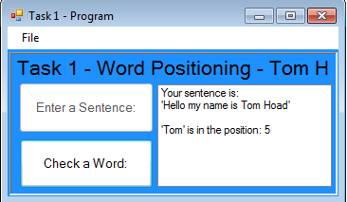
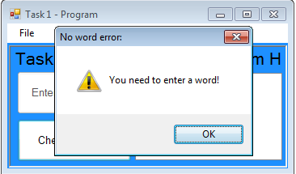
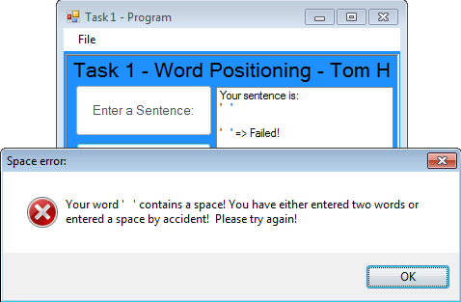
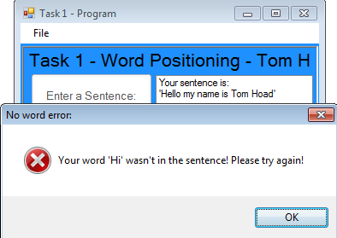
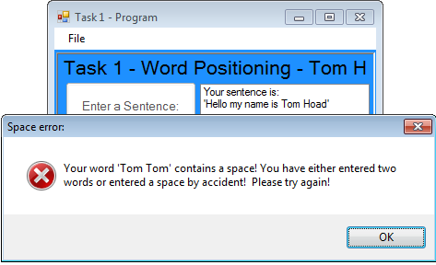
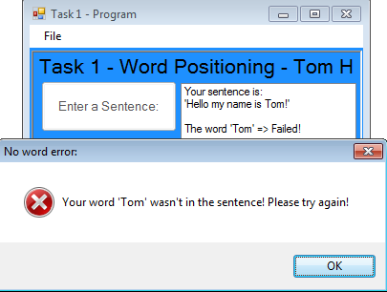
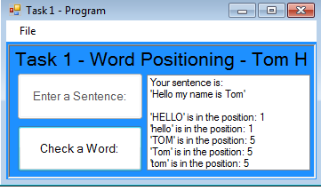
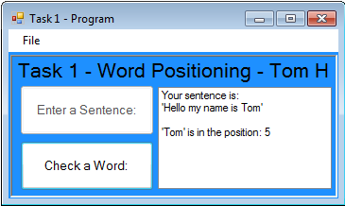
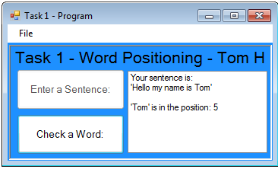
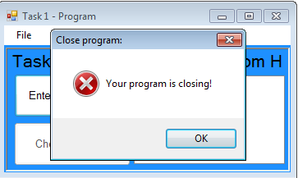

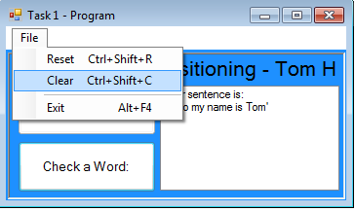
Name: Thomas Hoad Candidate Number: 2306 School: Calthorpe Park School Subject: Computing Centre Number: 58333
Figure 2 – A: Figure 2 – B: Figure 2 – C:
Figure 2 – D: Figure 2 – E: Figure 2 – F:
Figure 3 – A: Figure 3 – B: Figure 3 – C:
Figure 4 – A: Figure 4 – B: Figure 4 – C:

